Slide 1
Anomaly Detection In Web Application Using Machine Learning
Under Supervision Of:- Mr. Abhishek Chavan Sir
Submitted By:-Arpit Raj
Aishwary Pratap Singh
Himanshu Warudkar
Suhas Kulkarni

Slide 2
Introduction
We're focusing on "Anomaly Detection in Web Applications using Machine Learning." Our project addresses the growing need for automated analysis of server logs .
Key Points:
Significance: As web applications become more vital, their reliability and security are paramount. Manual log analysis is impractical due to increasing log sizes.
Automated Anomaly Detection: We've developed a machine learning-driven system to automatically identify anomalies in real-time, helping administrators respond swiftly.
Benefits: Proactive administration offers downtime prevention, enhanced security, optimized performance, and data-informed decision-making.

Slide 3
Project Overview
Our project centers on automating anomaly detection in web applications using a robust three-tier architecture. This architecture adheres to standard web server logging practices and transforms logs into proactive tools for administrators.
Key Points:
Three-Tier Architecture: Our system comprises Presentation, Logic, and Data tiers. This design enables efficient log processing, feature extraction, and real-time analysis.
Web Server Logging Practices: Our system aligns with industry-standard logging practices, ensuring compatibility and integration with various web servers without extensive customization.
Proactive Tools: Server logs are elevated from records to insights. Administrators can gain real-time insights, prevent downtime, enhance security, and make informed decisions using our system.

Slide 4
Importance of Anomaly Detection
We highlight the critical role of anomaly detection in ensuring the reliability and security of web applications. Detecting anomalies early can avert downtime and mitigate security breaches.
Key Points:
Reliability and Security: Anomalies can indicate issues before they escalate, safeguarding the application's reliability and maintaining a positive user experience.
Downtime Prevention: Identifying anomalies early allows administrators to address potential failures, reducing downtime and minimizing disruption.
Security Breach Mitigation: Anomalies can signal unauthorized access attempts or abnormal behavior, enabling swift action to prevent security breaches.
Operational Efficiency: Proactive anomaly detection optimizes resource allocation, ensuring efficient performance and resource utilization.

Slide 5
Machine Learning Approach
This introduces the concept of leveraging machine learning to automate anomaly detection, showcasing the benefits of using ML techniques for this purpose.
Explanation:
Automated Anomaly Detection: Machine learning enables us to automate the process of identifying anomalies within web application logs. Instead of manual analysis, ML algorithms can learn patterns and deviations from historical data.
Advantages of ML:
Scalability: ML techniques can efficiently handle large volumes of data, making them suitable for analyzing extensive log files and adapting to growing data sizes.
Continuous Learning: ML models continuously learn from new data, adapting to evolving patterns and ensuring relevance as the application environment changes.
Complex Pattern Recognition: ML algorithms excel at recognizing complex patterns and subtle deviations, which might be difficult to capture through traditional rule-based methods.
Reduced Human Bias: ML reduces human intervention, minimizing subjective interpretations and bias in anomaly detection.

Slide 6
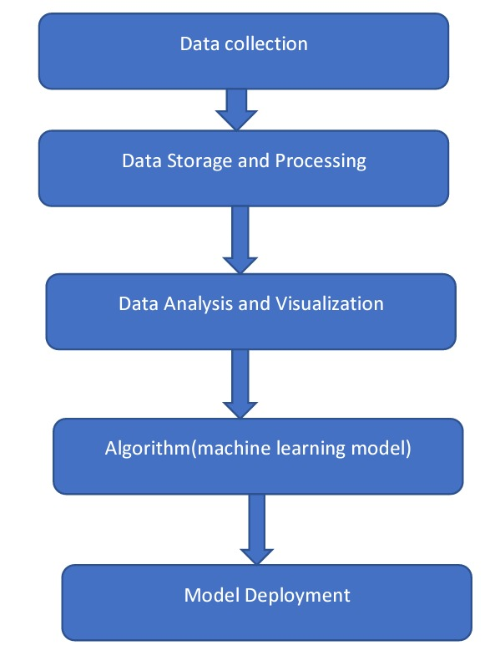
Project Flow

Slide 7
Functional Requirements
Data Collection
The data types available for anomaly detection: successful operations and failure warnings. The process involves continuous collection of server logs capturing user interactions and responses. Preprocessing prepares the data for further analysis.
Feature Engineering
This elaborates on feature engineering, the process of extracting relevant attributes from server logs. Effective features are crucial for accurate anomaly detection, capturing unique patterns of normal and anomalous behavior. Dimensionality reduction techniques like PCA can streamline high-dimensional data.
Model Selection
In this , we introduce the process of choosing a suitable algorithm for anomaly detection. The Isolation Forest algorithm is highlighted as our choice due to its efficiency in constructing random decision trees. It excels in handling outliers and is less sensitive to irrelevant features, ensuring accurate anomaly isolation.

Slide 8
Anomaly Detection Workflow:
Training and Validation: Historical data trains the Isolation Forest model, validated to ensure accuracy and optimize parameters.
Anomaly Detection: Trained model processes log entries, assigning anomaly scores based on isolation from normal patterns.
Threshold Classification: Anomaly scores above the threshold are flagged as anomalies, forming the basis of detection.
Results Analysis:
Sample Outcomes: Presented are examples of successful anomaly detections and correct identifications of normal behavior.
False Positives/Negatives: Instances of missed anomalies and false alarms are discussed, offering insights for model refinement.
Scalability and Real-time: The system demonstrates scalability for growing log volumes and real-time analysis for immediate anomaly detection.

Slide 9
Benefits and Impact
Benefits:
Proactive Admin: Early anomaly detection empowers swift issue resolution.
Reduced Downtime: Timely identification minimizes disruptions.
Enhanced Security: Swift anomaly spotting safeguards user data.
Optimized Performance: Anomaly insights refine resource allocation.
Impact on Web Apps:
Reliability: Fewer failures ensure consistent user experiences.
Satisfaction: Uninterrupted service boosts user contentment.
Data Protection: Swift detection thwarts security breaches.
Efficiency: Precise insights optimize resource utilization.

Slide 10
Hardware , Software & Deployment
Hardware Requirements:
Advanced Processor: System must possess robust processing power for efficient data handling.
Ample Storage: Vital for storing historical data, extracted features, and model artifacts.
Responsive System: Ensures real-time anomaly detection and swift issue resolution.
Recommended Hardware Example: Processor: i3 or higher RAM: ≥ 8GB
Software Requirements:
Python: Programming foundation for the solution's implementation.
Platforms: GitHub for version control, Jupyter Notebook for experimentation, and Kubernetes for containerized deployment.
Deployment Process Explanation:
Python: Utilized for its versatility and extensive machine learning libraries.
GitHub: Enables collaborative development, version control, and seamless code sharing.
Jupyter Notebook: Supports interactive code development and model optimization.
Kubernetes: Facilitates containerized deployment, ensuring consistency and scalability across environments.

Slide 11
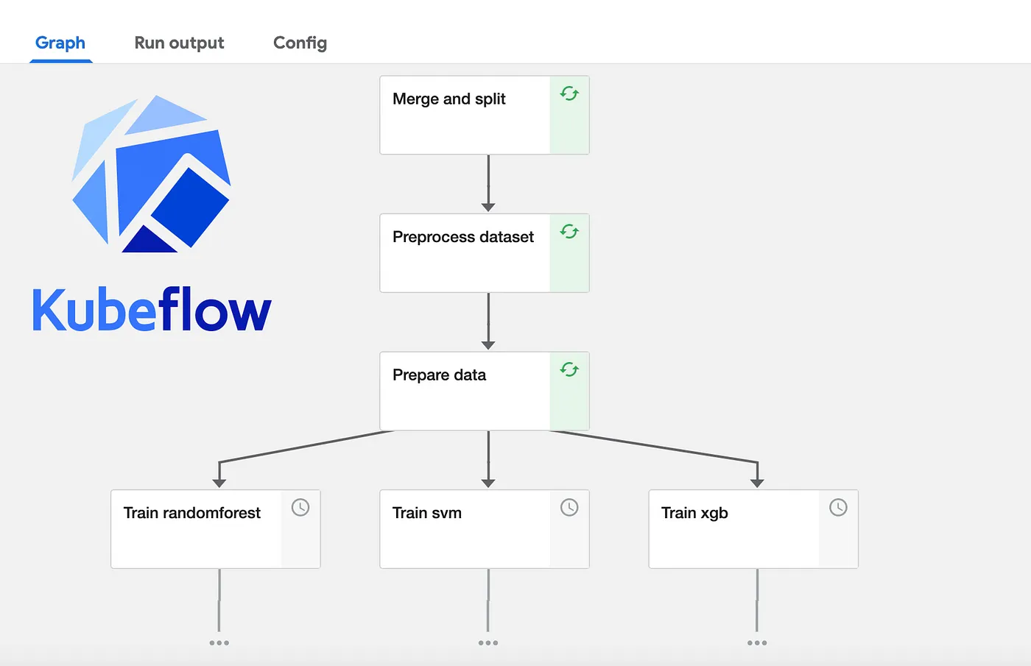
Project Pipeline

Slide 12
Conclusion
The conclusion of our project, "Anomaly Detection in Web Applications using Machine Learning," signifies the culmination of our efforts in enhancing web application management and security.
Our accomplishments include automating proactive administration, reducing downtime through timely anomaly identification, enhancing security measures by swiftly spotting anomalies, and optimizing performance with insights derived from anomaly patterns.
Looking forward, our focus lies in adopting advanced machine learning techniques for greater accuracy, expanding system compatibility across various web servers, and refining real-time analysis capabilities for immediate anomaly detection

Slide 13
Thank You

